Slide 1
INTERNATIONAL ECONOMIS
Course code- ECONA306
Class- BA 3rd year
Discipline Specific Elective
Session -2022-23
Gopal Bhardwaj
Assistant Professor
Dept. of Economics

Slide 2
Chapter 5: Intra-Industry Trade
An Introduction to International Economics: New Perspectives on the World Economy

Slide 3
Table 5.1: Types of Trade
Type of Trade | Phrase | Meaning | Source
Inter-industry | Either/or | Either imports or exports in a given sector of the economy | Comparative advantage
Horizontal intra-industry | Both/and/ same | Both imports and exports in a given sector of the economy at the same stage of processing. | Product differentiation
Vertical intra-industry | Both/and/ different | Both imports and exports in a given sector of the economy at different stages of processing. | Fragmentation (comparative advantage in some instances)

Slide 4
Global Patterns of Intra-Industry Trade
Approximately one third of world trade takes place as intra-industry trade
Especially prominent in manufactured goods among the developed or high-income countries of the world
  Probably accounts for up to 70% of trade
Globally, intra-industry trade is becoming more important over time, particularly in eastern Asia
Evidence suggests that western Asia (including Middle East) and most of Africa participate very little in intra-industry trade

Slide 5
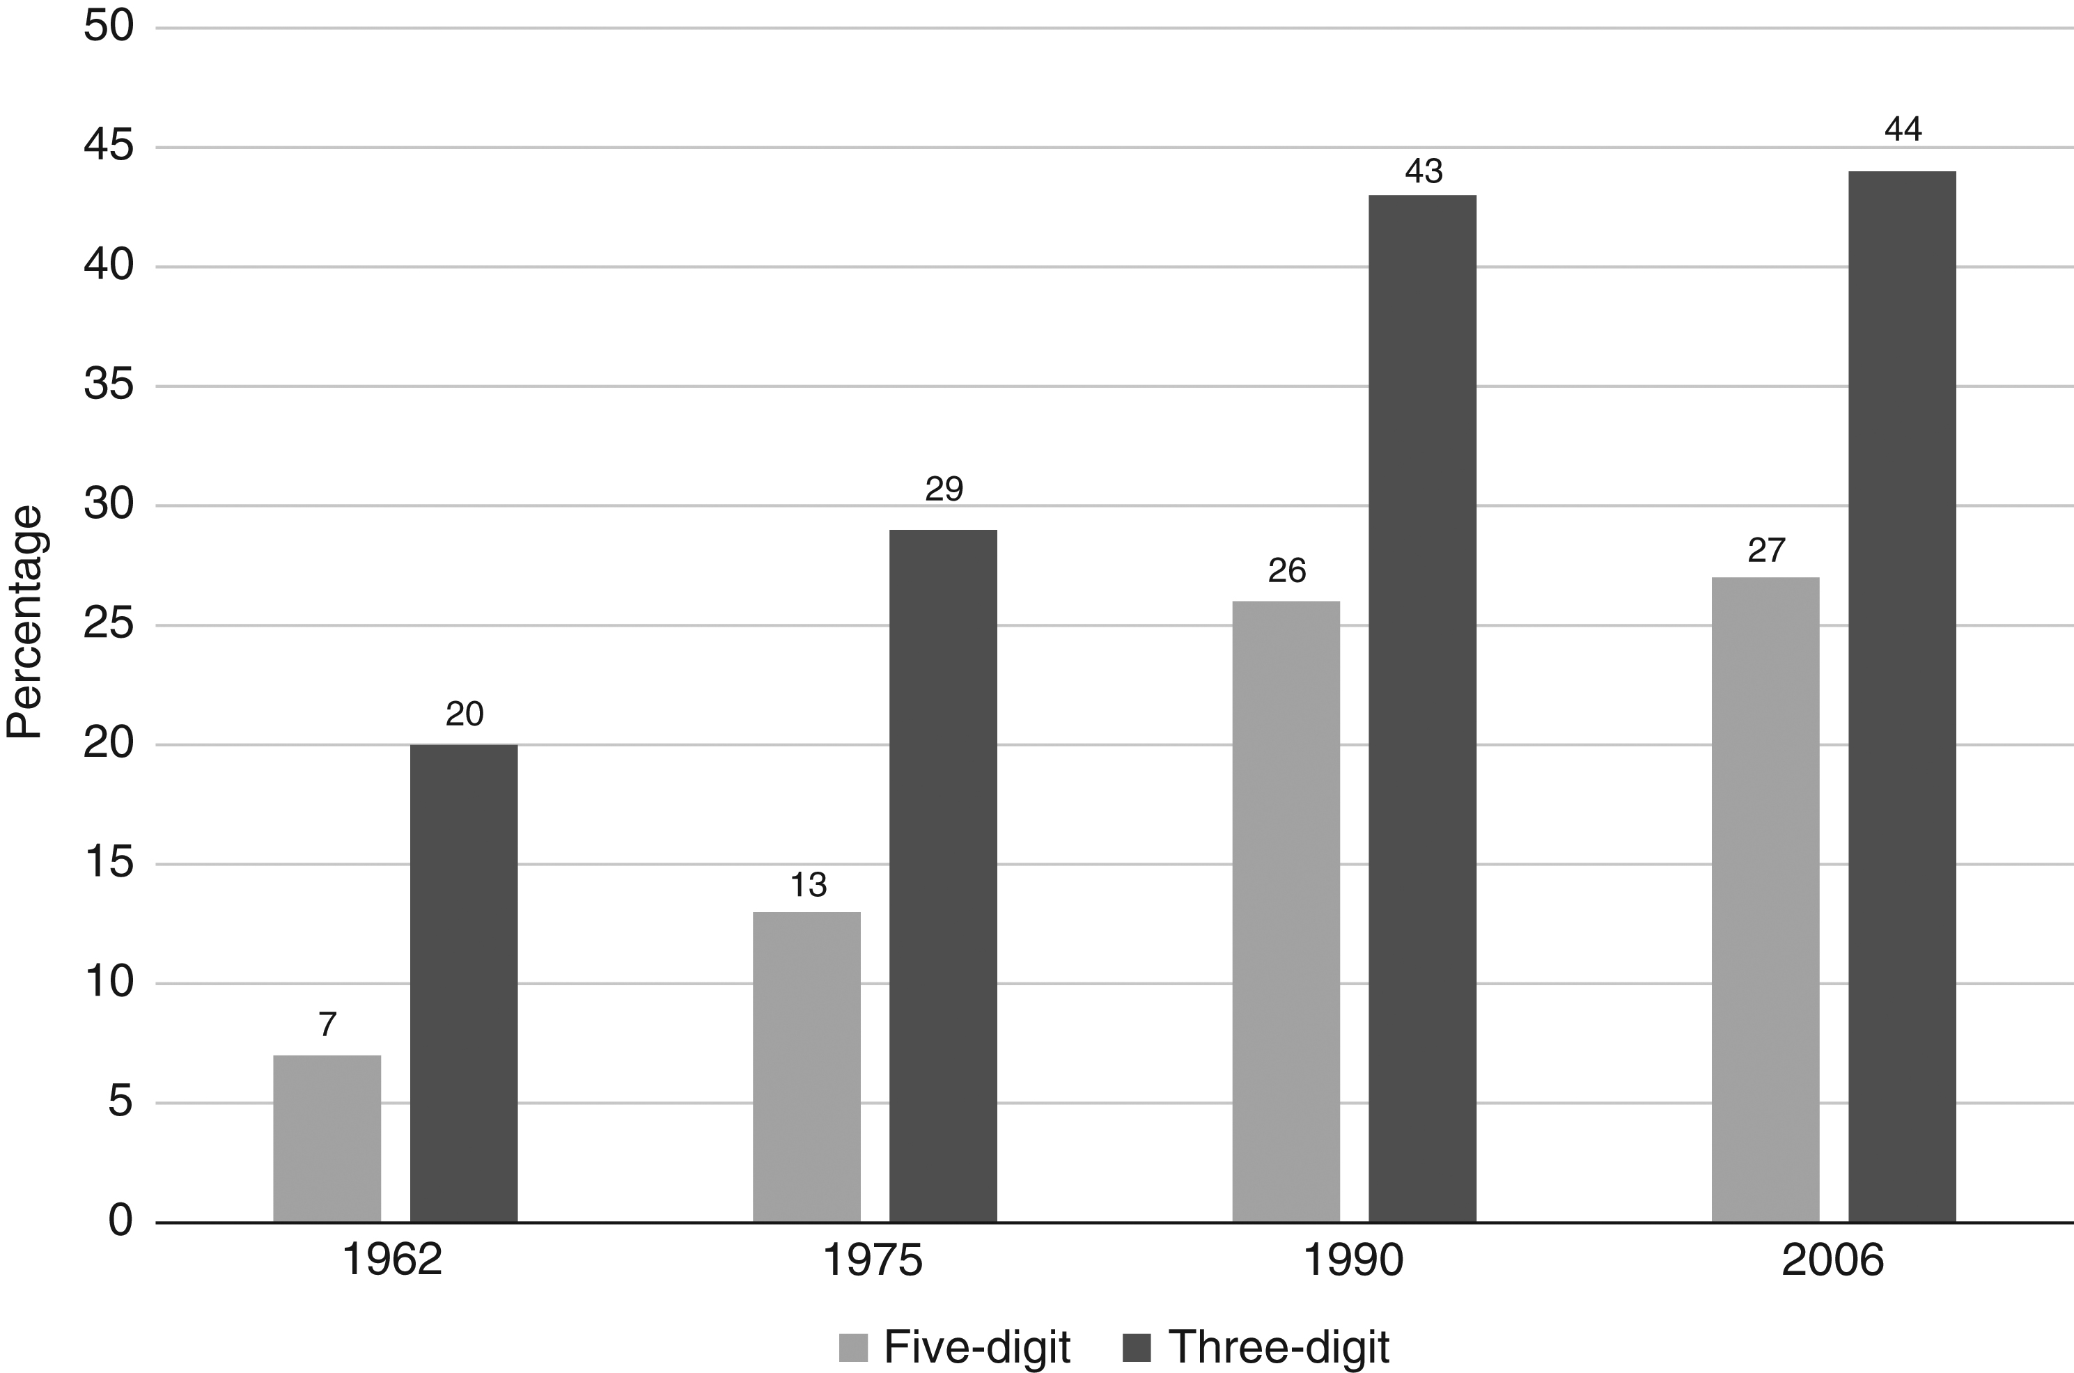
Figure 5.1 The Evolution of Intra-Industry Trade at the 5- and 3-Digit SITC Levels (percent of total trade)

Slide 6
Intra-Industry Trade under Monopolistic Competition
“New trade theory”: modeling intra-industry trade based on monopolistic competition
  Monopoly feature: firms face downward-sloping demand curves as they produce differentiated products
  Competition feature: firms have free entry and exit from the sector in long run
  Increasing returns to scale/economies of scale

Slide 7
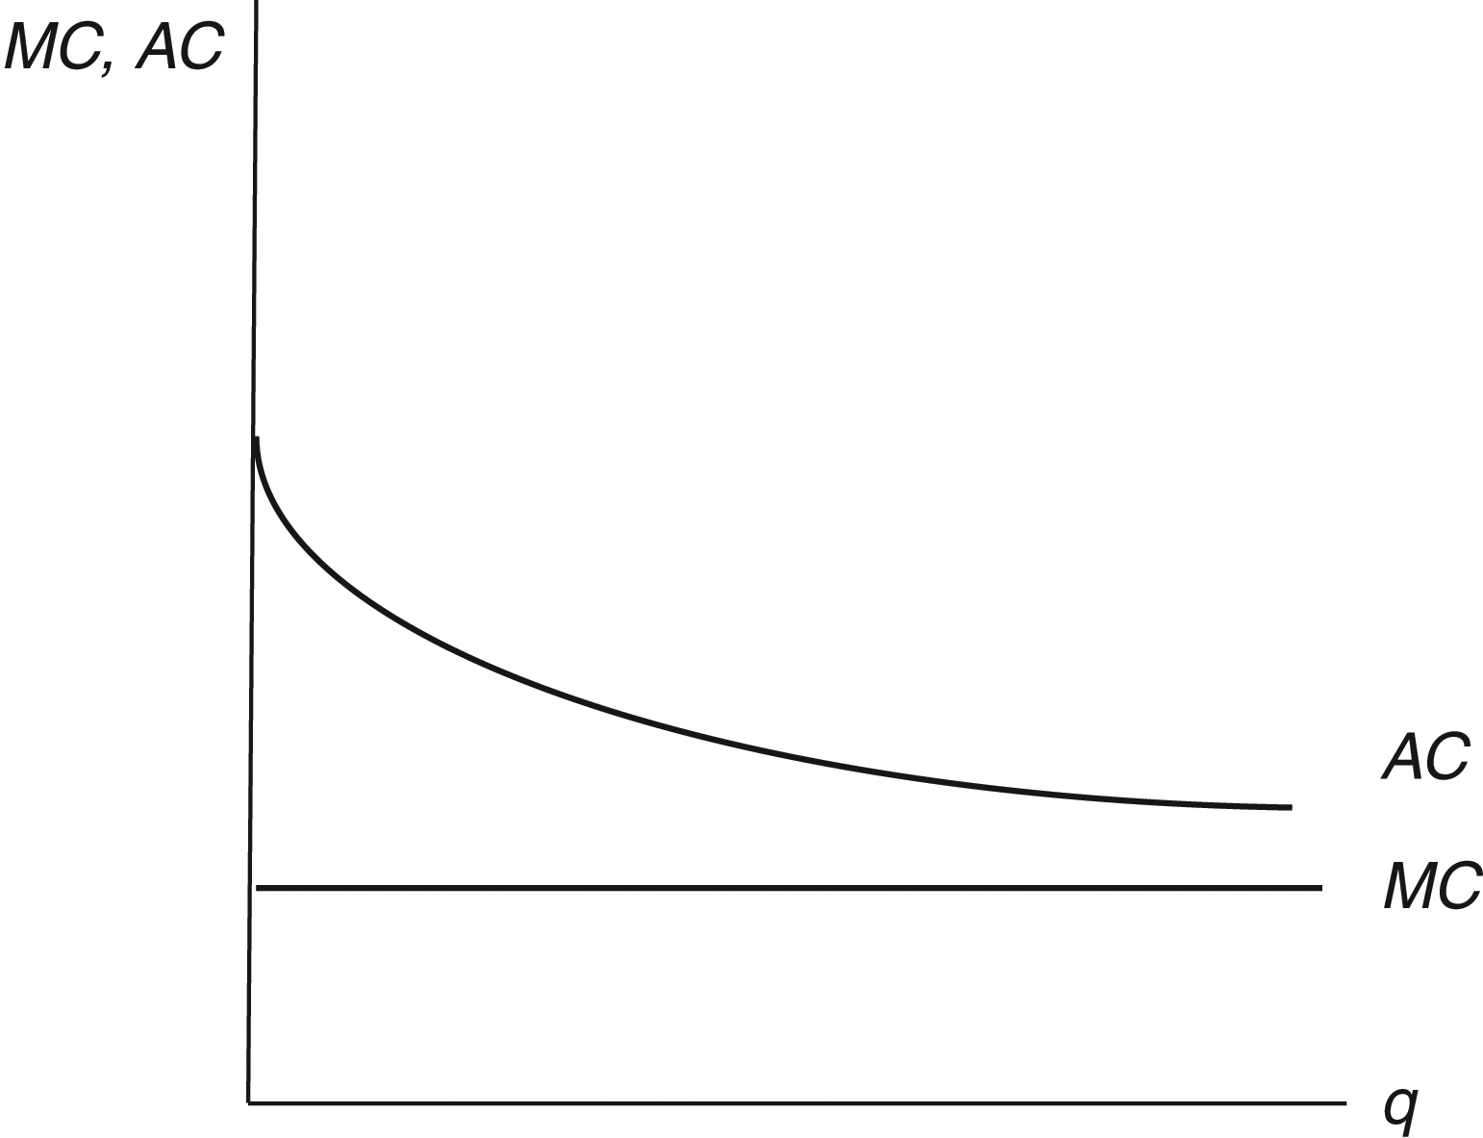
Figure 5.2 Economies of scale in the monopolistic competition model
Cost side:
AC line is falling because of economies of scale.
(note that these figures plot firm quantities, not sector quantities.)

Slide 8
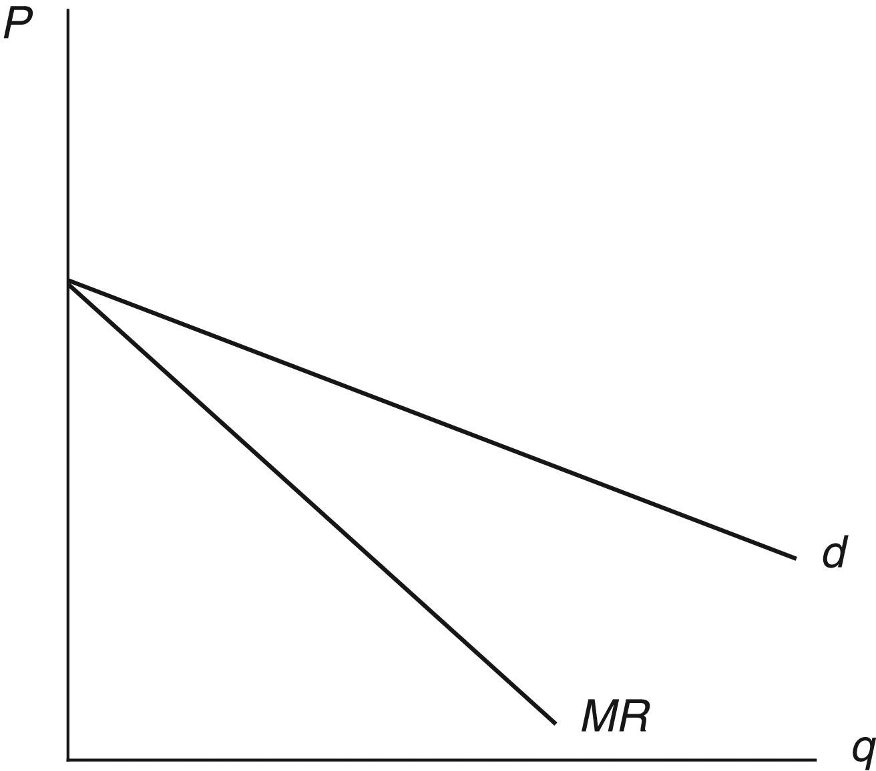
Figure 5.3 Demand and marginal revenue in the monopolistic competition model
Revenue side:
Demand curve is relatively flat because of a significant number of close substitutes
Whenever the firm increases its output, the price (p) falls

Slide 9
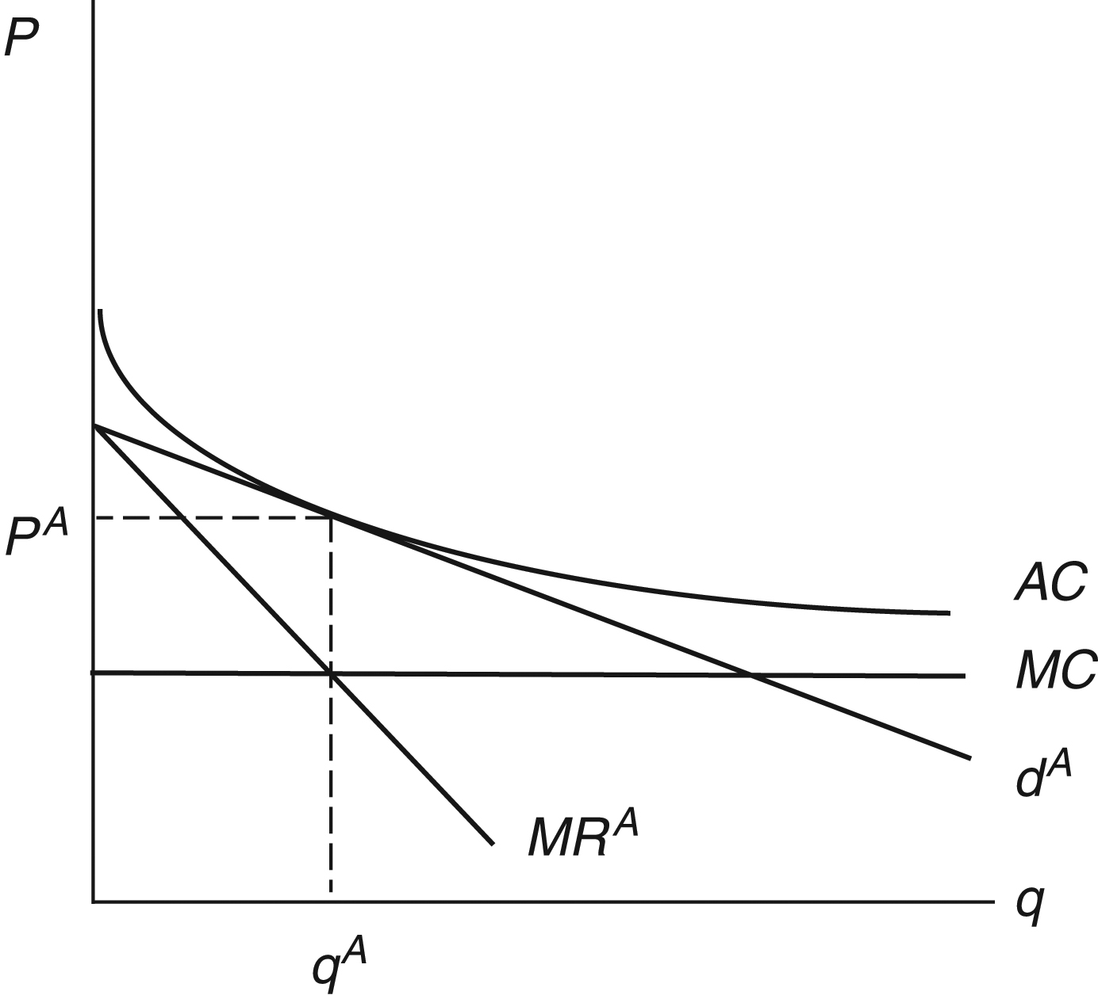
Figure 5.4 Autarky equilibrium in the monopolistic competition model
Combining the cost and the revenue sides:
Long-term equilibrium of autarky price and quantity

Slide 10
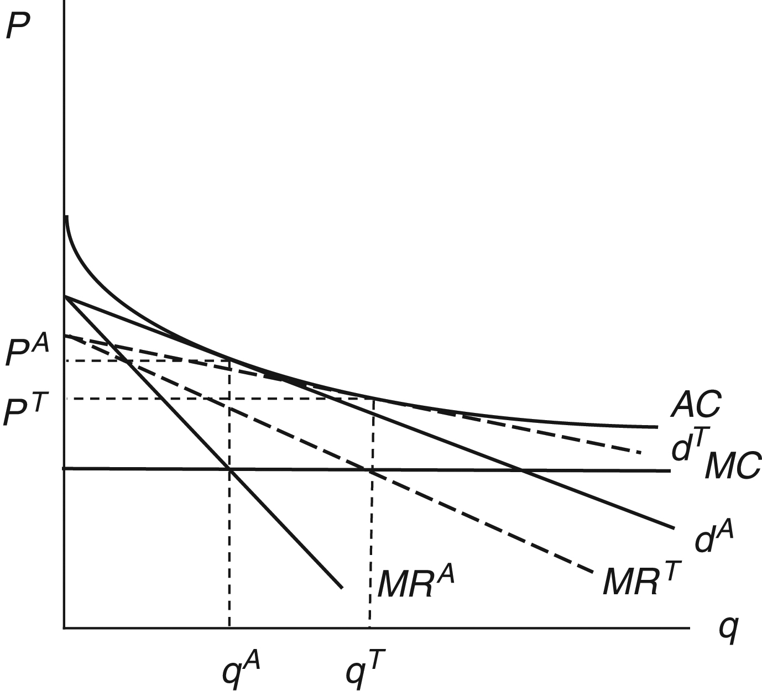
Figure 5.5 The effects of international trade in the monopolistic competition model
The main effect of trade is to expand the market in which firms compete.
Trade increases the price elasticity of demand for any individual firm.
Consequently, the demand curves becomes flatter.
The number of firms in the sector is lower as a result of trade, but the number of available varieties is higher as a result of trade, with more varieties imported from abroad.
Price falls
Quantity increases

Slide 11
Intra-Industry Trade under Monopolistic Competition
Product differentiation can lead to two-way trade within a sector.
Horizontal intra-industry trade: demand for final products can come from both households and firms.
Vertical intra-industry trade: demand for intermediate products only from firms
Gains from trade:
  Standard gains from trade reflecting lower prices
  Households have access to a variety of goods

Slide 12
The Smooth Adjustment Hypothesis
The increasing extent of intra-industry trade in world trading system has some important implications for the adjustment of economies to increasing trade
Increases in inter-industry trade based on absolute or comparative advantage involve import sectors contracting and export sectors expanding
  Requires that productive resources, most notably workers, shift from contracting to expanding sectors in order to avoid unemployment
  Not always an easy process—often gives rise to calls for protection

Slide 13
The Smooth Adjustment Hypothesis
The adjustment process in the case of intra-industry trade is very different
  A given sector experiences increases in imports and exports simultaneously
    Workers are less likely to need to shift between sectors
    Demands for protection from increased imports are less likely
This is known as the “smooth adjustment hypothesis”
Smoothness:
  Inter-industry trade: Low (not at all smooth)
  Vertical intra-industry trade: Medium (somewhat smooth)
  Horizontal intra-industry trade: High (smooth)

Slide 14
The Grubel-Lloyd Index for China
The Grubel-Lloyd Index for China is presented in Table 5.2
Note as we disaggregate further (moving from right to left), the amount of intra-industry trade declines but does not disappear
Note that the amount of intra-industry trade increases over time

